Slide 1
Lecture 9 Multimedia Communication Systems
Application Subsystem
Transport Subsystem
Quality of Service And Resource Management

Slide 2
Application Subsystem
Collaborative Computing
CSCW (Computer Supported Cooperative Work)
E.g. Electronic mail, bulletin boards, social networking, chat engine, conference systems, screen sharing tools

Slide 3
Collaborative Dimensions
Can be categorized according to: time, user scale, control
Time : asynchronous (processing activities that do not happen at the same time e.g email) and synchronous (cooperative work that happens at the same time (e.g conferencing)
User scale: specifies whether a single user collaborates with another user or a group of more than two users collaborate together.
Groups can be further classified as
Static (pre-determined participating members and membership does not change during the activity) or dynamic (group members can join or leave the activity at any time)
Group members may have different roles in CSCW like a conference initiator, conference chairman, token holder, an observer, member of a group etc
Group members may have homogeneous or heterogeneous characteristics
Control: Centralized (there is a chairman who controls the collaborative work and every group member reports to him or Decentralized (every group member has control over his/her own tasks and distributed control protocols are in place to provide consistent collaboration

Slide 4
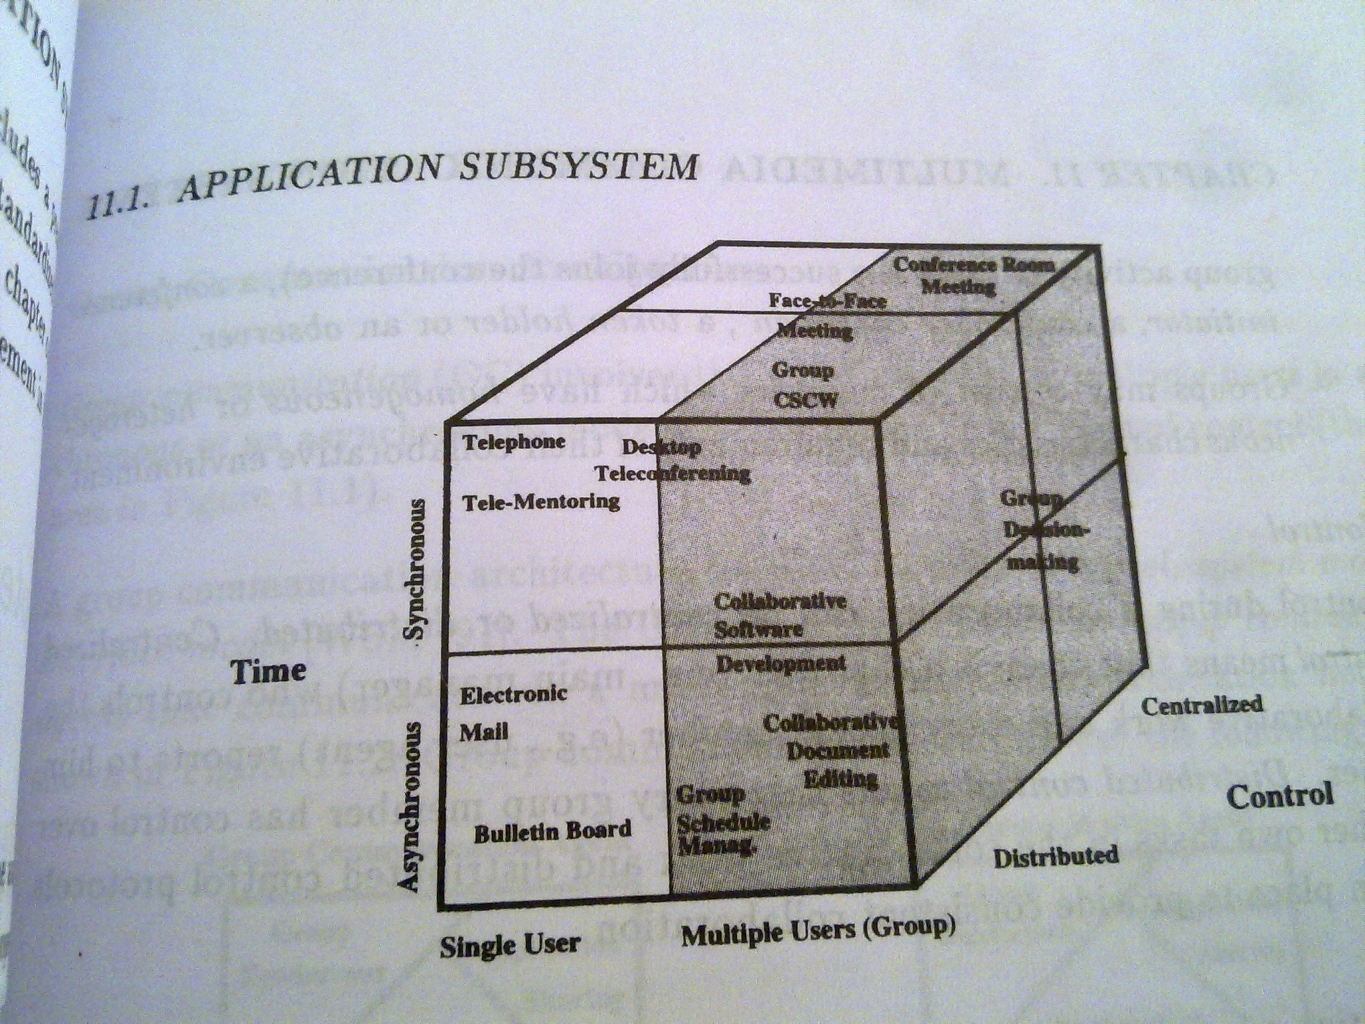
figure

Slide 5
Group communication (GC) Architecture
GC involves the communication of multiple users in a synchronous or an asynchronous mode with centralized or distributed control
GC architecture consists of a support model, system model and interface model
GC support model includes group communication agents that communicate via a multicast communication network
Group communication agents use Group Rendezvous, Shared Applications, and Conferencing for their collaboration

Slide 6
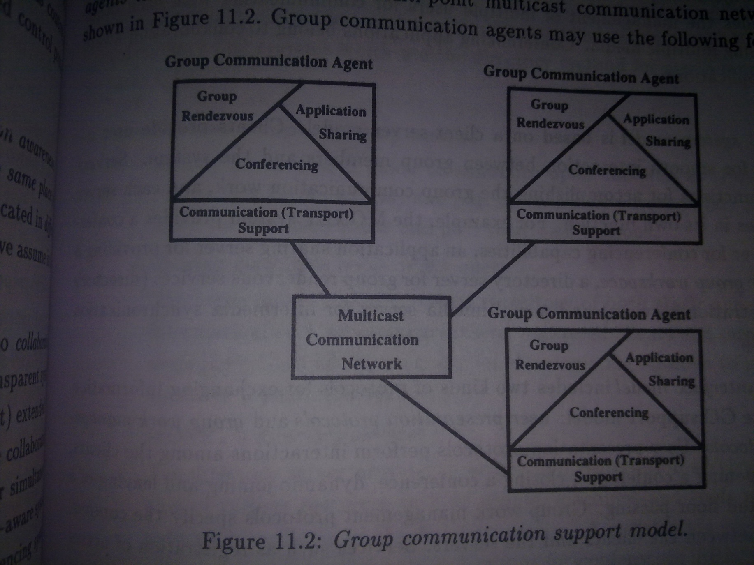

Slide 7
Group Rendezvous – denotes a method which allows one to organize meetings, and to get information about group, ongoing meetings and other static and dynamic information
Shared Applications – denotes techniques which allows one to replicate information to multiple users simultaneously. The remote users may point to interesting aspects (via telepointing) of the information and modify it so that all users can immediately see the update information (e.g joint editing)
Conferencing – simple form of collaborative computing, provides the management of multiple users for communicating with each other using multiple media

Slide 8
Session Management
An important (core) part of the multimedia communication architecture which separates the control, needed during the transport, from the actual transport
Architecture – built around an entity – session manager

Slide 9
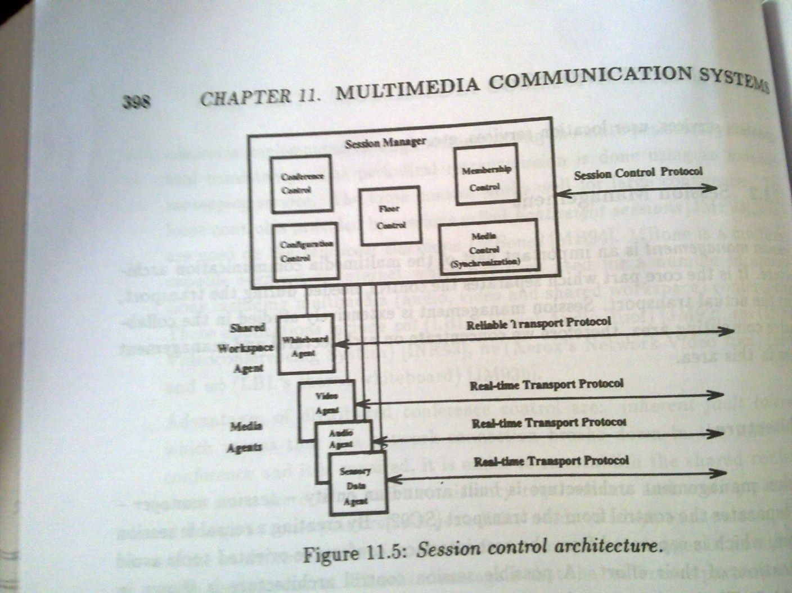
Session Control Architecture

Slide 10
Session Control Architecture
Session manager – includes local and remote functionalities
Local functionalities – includes membership control (participant authentication, presentation of coordinated user interface), control management for shared workspace (floor control), media control management (interconnection among media agents – synchronization), configuration management (exchange of interrelated QoS parameters or selection of appropriate according to QoS, Conference Control Management (establishment, modification and a closing of a conference)
Remote functionalities – communication with other session managers to exchange session state information which may include the floor information, configuration information etc
Media Agents – responsible for decisions specific to each type of media
Allows a replacement of agents, each agent performs its own control mechanism over the particular medium like mute, unmute, change video quality, start sending, stop sending etc.
Shared Workspace Agent – transmits shared objects (telepointer coordinate, graphical ot textual object) among the shared applications

Slide 11
Control
Floor Control – is employed to provide access to the shared workspace
To maintain data consistency
To enforce access control – floor passing mechanism (only one participant has the floor at any time)
Floor handed off to another participant when requested, to obtain floor the participant must explicitly take action to signal a floor change
Conference Control
Media Control – includes a functionality synchronization of media streams
Configuration Control – includes a control of mdeia quality, QoS handling, resource availability and other system components to provide a session according to user requirements
May embed services (negotiation and renegotiation of media quality)
Membership Control – include services: invitation to a session, registration into a session, modification of the membership during the session etc.

Slide 12
Transport Subsystem – brief overview of transport and network protocols and their functionalities
Requirements – User and Application
Data throughput – especially audio and video data
Fast Data forwarding
Service Guarantees
Multicasting

Slide 13
Transport Layer
TCP (Transmission Control Protocol)
UDP (User Datagram Protocol)
RTP (Real-time Transport Protocol)
Suitable for applications transmitting real time data or simulation data over multicast or unicast network services
Primarily designed to satisfy the needs of multiparty multimedia conferences, but not limited to that particular application
Does not address resource reservation and does not guarantee QoS for real-time serivces
XTP (eXpress Transport Protocol)

Slide 14
Network Layer
IP (Internet Protocol)
IGMP (Internet Group Management Protocol)
RSVP (Resource reSerVation Protocol)

Slide 15
Quality of Service (Qos)
A concept for specifying how good the offered networking services are
Can be categorized by a number of specific parameters
QoS layered model for the MCS (in the next slide)

Slide 16
User
(User QoS)
Application
(Application QoS)
System
(Operating and Communication system)
(System QOS)
(Network QoS)
(Device QoS)
Network
MM Devices

Slide 17
QoS parameters
The set of chosen parameters for the particular service determines what will be measured as QoS
Most of the current QoS parameters differ from the parameters described in ISO because the variety of applications, media sent and the quality of the networks and end systems
Hence many different parameters are possible

Slide 18
QoS parameters (Contd.)
Possible set of QoS parameters for each layer
Application QoS Parameters – describe requirements for the application services possibly specified in terms of
Media quality – which includes the media characteristics and their transmission characteristics, such as end to end delay
Media relations – which specify the relations among media, such as media conversion or inter/intra stream synchronization

Slide 19
QoS parameters (Contd.)
System QoS parameters- describe requirements on the communication services and OS services resulting from the application QoS, specified in terms of quantitative and qualitative criteria
Quantitative criteria – those which can be evaluated in terms of certain measures, such as bps (bits per second), no. of errors, task processing time, PDU size etc.
Qualitative criteria – specify the expected services needed for provision of QoS, such as interstream synchronization, ordered delivery of data, error recovery mechanism, scheduling mechanism etc.
Can be used by the coordination control to invoke proper services for particular applications

Slide 20
QoS parameters (Contd.)
Network QoS parameters – describe requirements on network services, specified in terms of
Network load – describing the ongoing network traffic and characterized through average/minimal inter arrival time on the network connection, packet/cell size, and service time in the mode for the connection’s packet cell.
Network performance – describing the requirements which the network services must guarantee
performance might be expressed through a source to destination delay bound for the connection’s packet and packet loss rate
other parameters bandwidth, delay-jitter (max. difference between end to end delays experienced by any two packets)

Slide 21
QoS parameters (Contd.)
Device QoS parameters – specify timimg and thtoughput demands for media data units

Slide 22
QoS parameter values and types of service
Guaranteed services – provide QoS guarantees, as specified through the QoS parameter values either in deterministic statistical representation
Deterministic bounds can be given through a single value( e.g. average value, contractual value, threshold value, target value), a pair of values (e.g. min and average value, lowest quality and target quality) or an interval of values (lower bound is the min value and upper bound is the max. value)
statistical bounds on error rate etc

Slide 23
QoS parameter values and types of service (Contd.)
Predictable services (historical services) – based on past network behavior
Hence the QoS parameters are estimates of past behavior which the service tries to match
Best effort services – services based on either no guarantees or no partial guarantees
There is either no specification of QoS parameters required, or some bound in deterministic or statistical forms are given
Most of the current network protocols have best effort services

